Slide 1
CS 201 – DATA STRUCTURES
TREES

Slide 2
Trees data structure introduction
Hierarchical representation
Better than linked list and array
Used for graph traversals
BFS and DFS
Postfix and prefix conversion
In order traversal, pre-order traversal and post order traversal

Slide 3
Binary tree
Having at most 2 children.
Node class has three members: data value of the node, pointer to left child and pointer to right child

Slide 4
Types of traversal
In order traversal: left-parent-right
Post order traversal: left-right-parent
Pre order traversal: parent-left-right

Slide 5
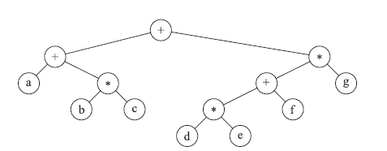
Application of tree: Expression tree
(a + b * c) + ((d * e + f ) * g)

Slide 6
Binary search tree
Also called as sorted binary tree
Structure: left child has lesser (or equal to) value than the parent and right child has higher value
Main functions: insert, delete, search, constructor, destructor, asg operator and copy constructor

Slide 7
BST Functions
Contains
Insertion
Size
Find min/max
Mirror solution
Check if tree is BST
Deletion

Slide 8
Parent threaded trees
Get free from utilizing stack space.
Incorporating threads in a given node
there are many nodes that have an empty left child or empty right child or both.
utilize these fields in such a way so that the empty left child of a node points to its in-order predecessor and empty right child of the node points to its in-order successor.

Slide 9
Problems in binary tree or BST
Skewness
Complexity can reach till O(n) – becomes just like a linked list traversal.
In general the complexity is O(height of tree)

Slide 10
Solution
DSW algorithm
AVL trees

Slide 11
DSW algorithm
Concept of rotation arises
First create a backbone
Then start balancing

Slide 12
Gp=null, parent=root, leftchild
While(parent!=null){
leftchild=parent->left
if(leftchild!=null){
if(Gp!=null)
gp->right = leftchild
else
root=leftchild
parent->left=leftchild->right
leftchild->right=parent
parent=leftchild
}
else{
gp=parent
parent=parent->right
} }

Slide 13
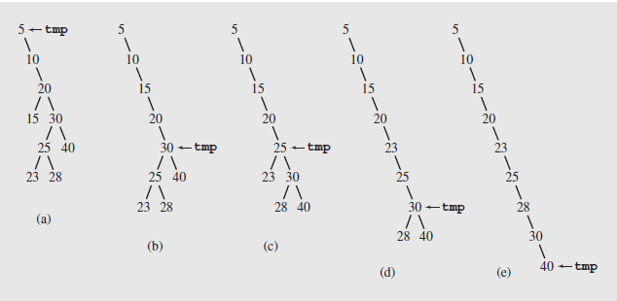
Example of creating backbone

Slide 14
Next step: make rotations
createPerfectTree()
n = number of nodes;
m = 2^⎣lg(n+1)⎦-1;
make n-m rotations starting from the top of backbone;
while (m > 1)
m = m/2;
make m rotations starting from the top of backbone;

Slide 15
makeRotations( bound) {
gp= null; Node , parent = root, rightchild = root->right;
while(bound>0){
if (rightchild!=null) {
if (gp!=null)
grandParent->right = rightChild;
else
root = rightChild;
parent->right = rightChild->left;
rightChild->left = parent;
gp = rightchild;
parent = gp->right;
rightchild = parent->right;
} else
break;
bound--;

Slide 16
Example
15, 20, 24, 10, 13, 7, 30, 36, 25
14, 17, 11, 7, 53, 4, 13, 12, 8

